Slide 1




AKUSUKAPROJECT
Siaga Padang
Sistem Navigasi Evakuasi Tsunami Luring Berbasis Pemodelan Pergerakan Kolektif
Tim AkuSukaProject — GEMASTIK XIX
Divisi VIII Pengembangan Perangkat Lunak
Mikail Samyth Habibillah, Muhammad Habib, Sheva Ramadhan
Dosen Pembimbing: Nisa Dwi Angresti, S.Si., M.Kom.
Universitas Andalas
-

Slide 2

TSUNAMI AWARENESS
UNDERSTANDING, PREPARING, AND STAYING SAFE
AKUSUKAPROJECT
Latar Belakang

Slide 3
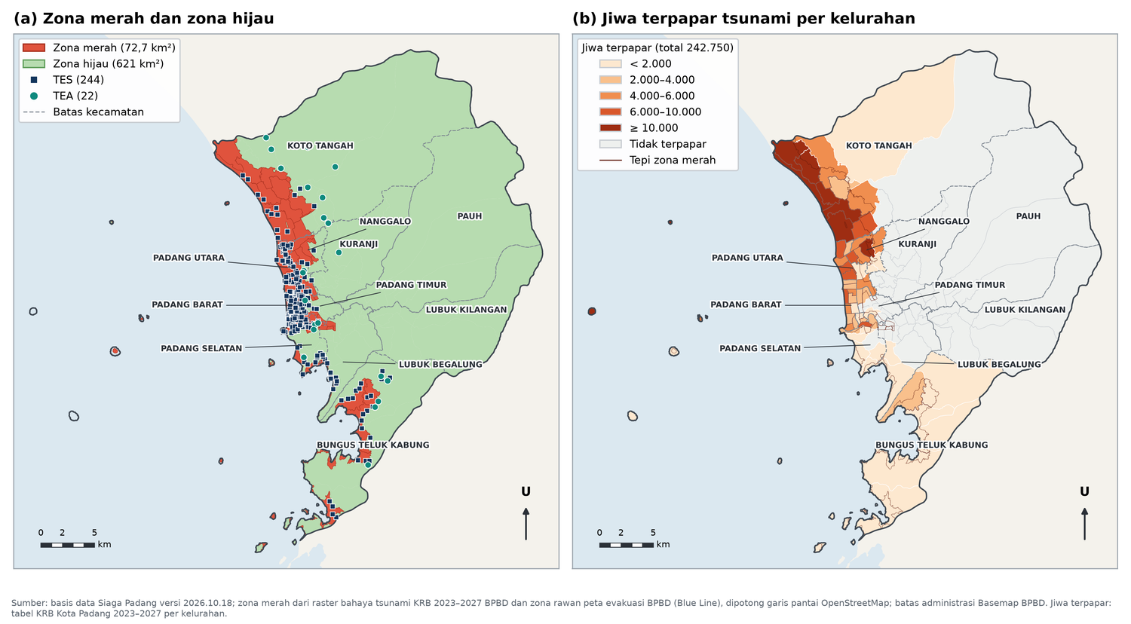
AKUSUKAPROJECT
TSUNAMI DAPAT TIBA KURANG DARI 30 MENIT SETELAH GEMPA
M 8,9
SKENARIO GEMPA MEGATHRUST MENTAWAI–SIBERUT (BMKG)
> 10 M
PERKIRAAN TINGGI TSUNAMI DI PESISIR KOTA PADANG
8 KEC · 55 KEL
WILAYAH TERANCAM, 242.750 JIWA TERPAPAR (KRB)
77.014
JIWA KELOMPOK UMUR RENTAN DAN 637 PENYANDANG DISABILITAS

Slide 4
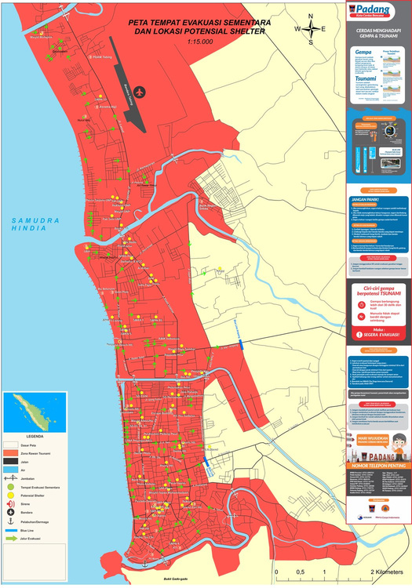
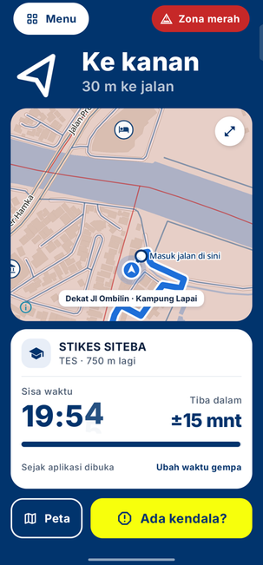
AKUSUKAPROJECT
KAMI MENGUBAH PETA MENJADI ARAHAN YANG LANGSUNG DIIKUTI
SEBELUM
YANG KAMI BANGUN
DENGAN SIAGA PADANG
Siaga Padang
Aplikasi Android yang membawa jalur
evakuasi ke dalam ponsel.
→
→
1
Membaca posisi pengguna
2
Memilih tujuan yang terjangkau
3
Mengikuti aturan BPBD
4
Tetap memberi arah tanpa internet
Arah, jalur, tujuan, dan
waktu tempuh tampil dari posisi saat itu
Cari posisi · orientasikan peta
· tentukan tujuan sendiri

Slide 5

RECOGNISING A TSUNAMI
UNUSUAL OCEAN BEHAVIOUR
STRONG OR UNUSUAL EARTHQUAKES
ONE OF THE MOST IMPORTANT NATURAL WARNING SIGNS IS A SUDDEN AND DRAMATIC WITHDRAWAL OF WATER FROM THE SHORELINE
A STRONG COASTAL EARTHQUAKE, ESPECIALLY ONE LASTING OVER 20 SECONDS OR MAKING IT HARD TO STAND, MAY SIGNAL A TSUNAMI
UNUSUAL SOUNDS FROM THE OCEAN
OFFICIAL WARNING SYSTEMS
SOME WITNESSES IN TSUNAMI-AFFECTED COASTAL AREAS HAVE REPORTED AN UNUSUAL ROARING OR RUMBLING SOUND APPROACHING FROM THE OCEAN
OFFICIAL TSUNAMI ALERTS ARE ISSUED BY AUTHORITIES AFTER MAJOR EARTHQUAKES AND SHARED THROUGH MULTIPLE CHANNELS

Slide 6
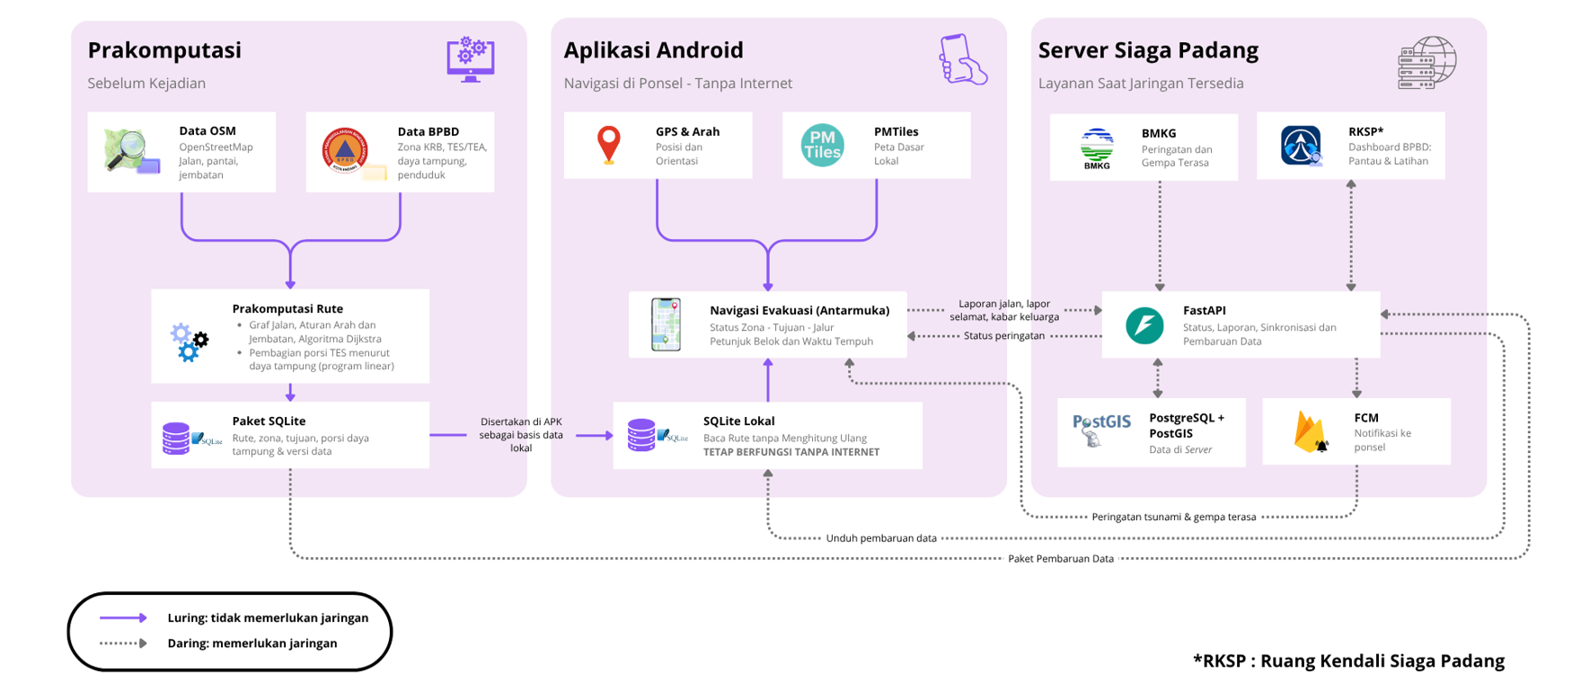
TSUNAMI AWARENESS
UNDERSTANDING, PREPARING, AND STAYING SAFE
AKUSUKAPROJECT

Slide 7



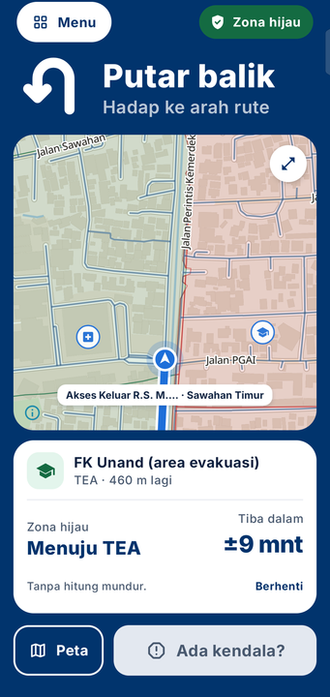
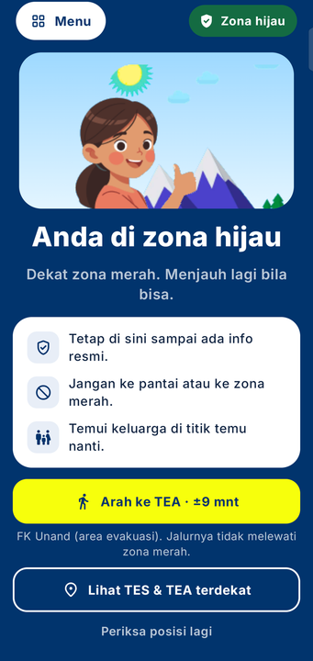




AKUSUKAPROJECT
NAVIGASI LURING DI LAPANGAN
Panah mengikuti arah hadap
Belum menghadap jalur: "Ke kiri", "Ke kanan", atau "Putar balik".
Petunjuk belok
Arah dicek tiap 12 m; < 28° bukan belokan; tampil saat belokan ≤ 50 m.
Masuk jalan di sini
Lebih dari 18 m dari jalur: garis putus-putus ke titik masuk terdekat.
Jalur dibaca ulang
Bila ≥ 40 m dari jalur lama pada tiga pembacaan; kembali dipilih bila menghemat ≥ 1 menit.
Kedatangan otomatis
Tiga pembacaan ≤ 20 m dari tujuan, ketelitian ≤ 35 m; lalu tawaran lanjut ke TEA.
Masuk jalan
Putar balik
Tiba di zona hijau

Slide 8
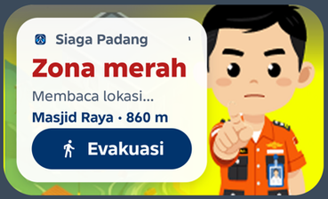
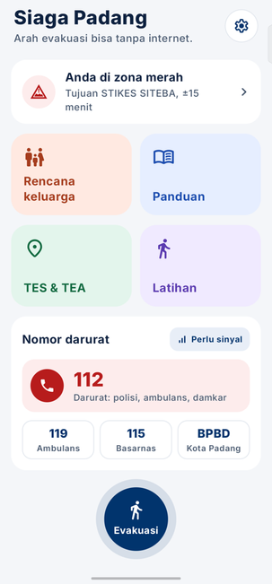
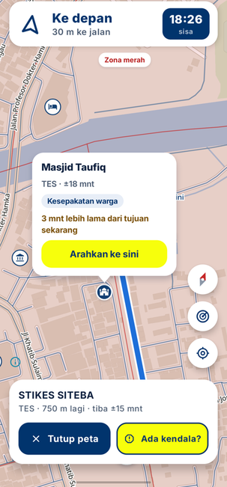
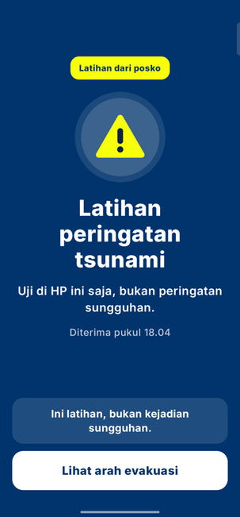
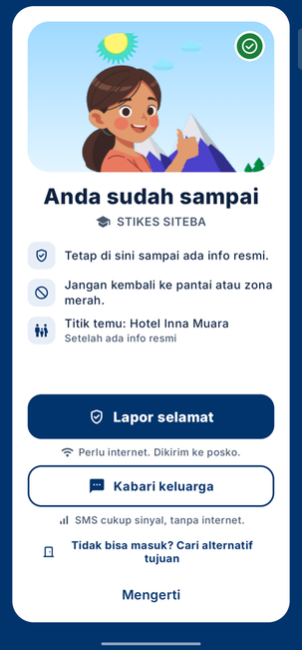
AKUSUKAPROJECT
ALUR APLIKASI DARI WIDGET SAMPAI KEDATANGAN
Widget 4×2: status zona, tujuan, jarak, tombol Evakuasi
Beranda
Arahan, mode pesawat
Rincian TES
Peringatan latihan
Kedatangan

Slide 9
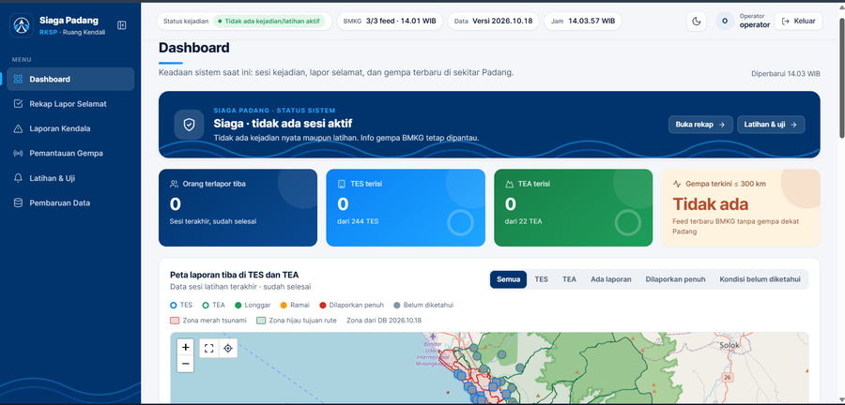
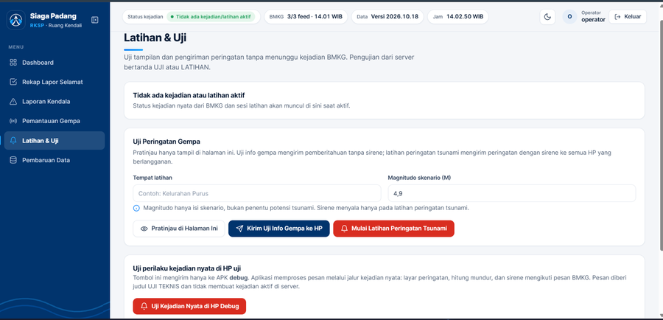
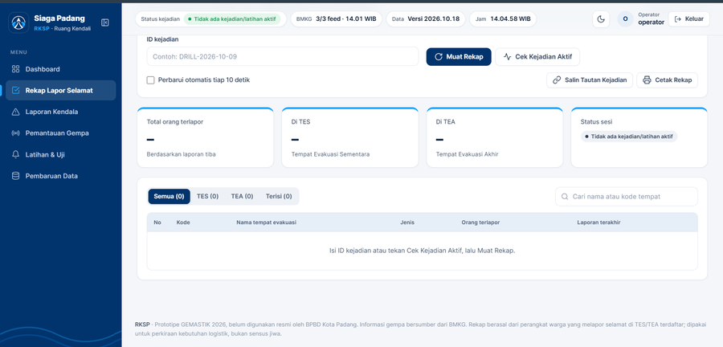
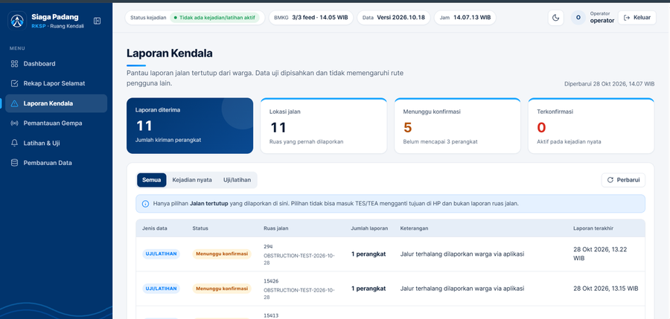
AKUSUKAPROJECT
WEB DASHBOARD RUANG KENDALI SIAGA PADANG (RKSP)
  Layanan: versi data, daftar tempat, informasi BMKG, lapor selamat, laporan jalan
  Laporan jalan terkonfirmasi bila 3 ponsel melaporkan ruas yang sama dalam 15 menit, ≤ 50 m
  Peringatan latihan berlabel LATIHAN; info gempa terasa dari BMKG
  Dashboard masih prototipe yang dioperasikan tim
Dashboard
Kirim peringatan latihan
Rekap lapor selamat
Laporan kendala

Slide 10

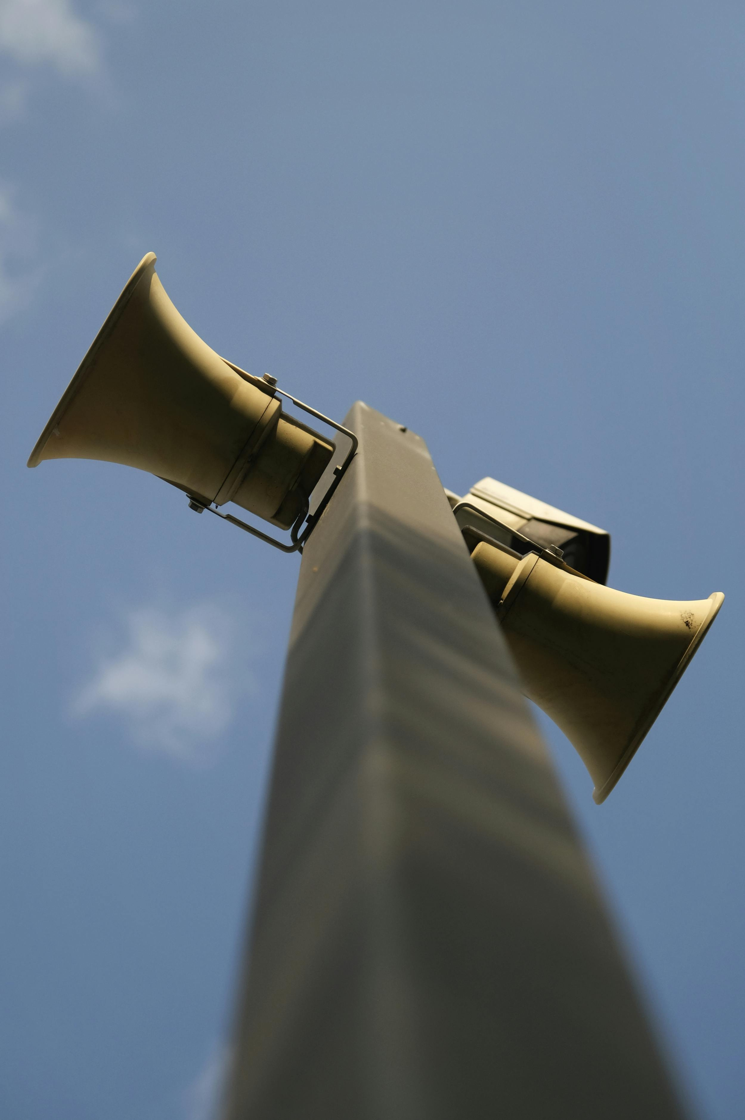
THE WARNING SYSTEM
NORTH ACADEMY
SEISMIC DETECTION — THE FIRST SIGNAL
OCEAN SENSOR CONFIRMATION — DART BUOYS
TSUNAMI WARNINGS BEGIN WITH SEISMIC MONITORING NETWORKS
DART BUOYS DETECT TSUNAMI WAVES IN THE OPEN OCEAN
WARNING CENTRE ASSESSMENT AND ISSUANCE
NATIONAL ALERT DISSEMINATION — MULTIPLE CHANNELS
REGIONAL WARNING CENTRES ASSESS TSUNAMI THREATS AND ISSUE ALERTS
NATIONAL AGENCIES DELIVER TSUNAMI WARNINGS THROUGH MULTIPLE CHANNELS
THE ALL-CLEAR — AN OFFICIAL PROCESS
MODERN TSUNAMI EARLY WARNING SYSTEMS COMBINE REAL-TIME SEISMIC MONITORING, OCEAN SENSORS, AND MULTI-CHANNEL PUBLIC COMMUNICATION TO PROVIDE THE MAXIMUM POSSIBLE LEAD TIME BETWEEN A GENERATING EVENT AND WAVE ARRIVAL AT SHORE
WARNINGS END ONLY AFTER AUTHORITIES CONFIRM THE DANGER HAS PASSED

Slide 11
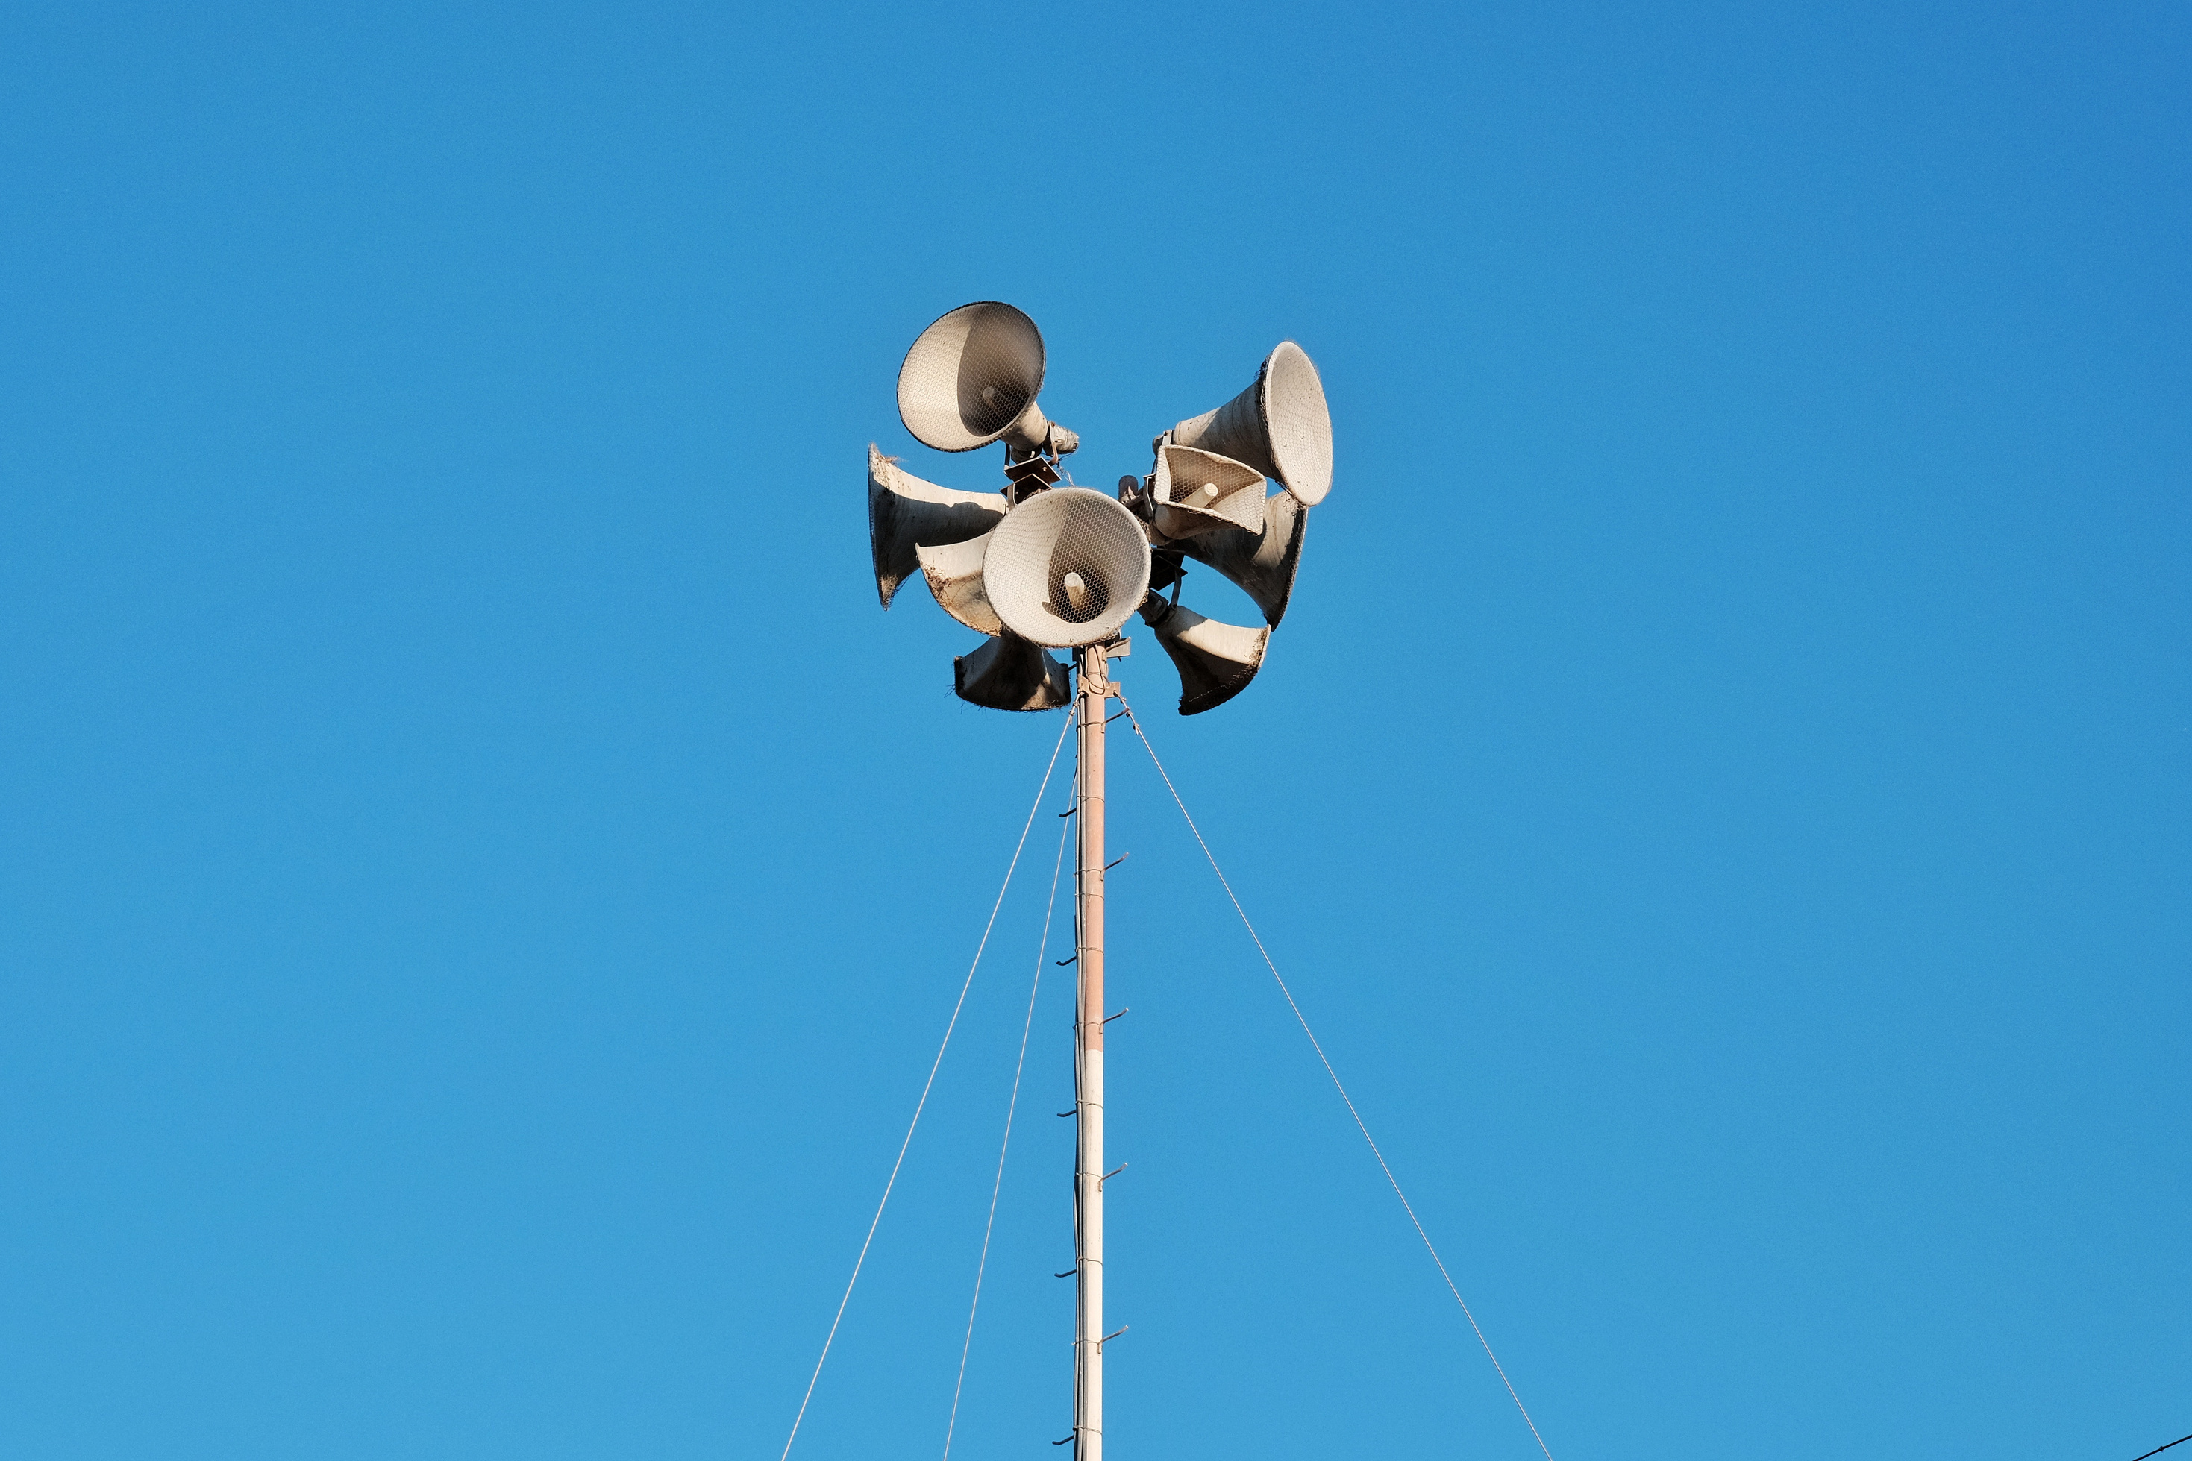
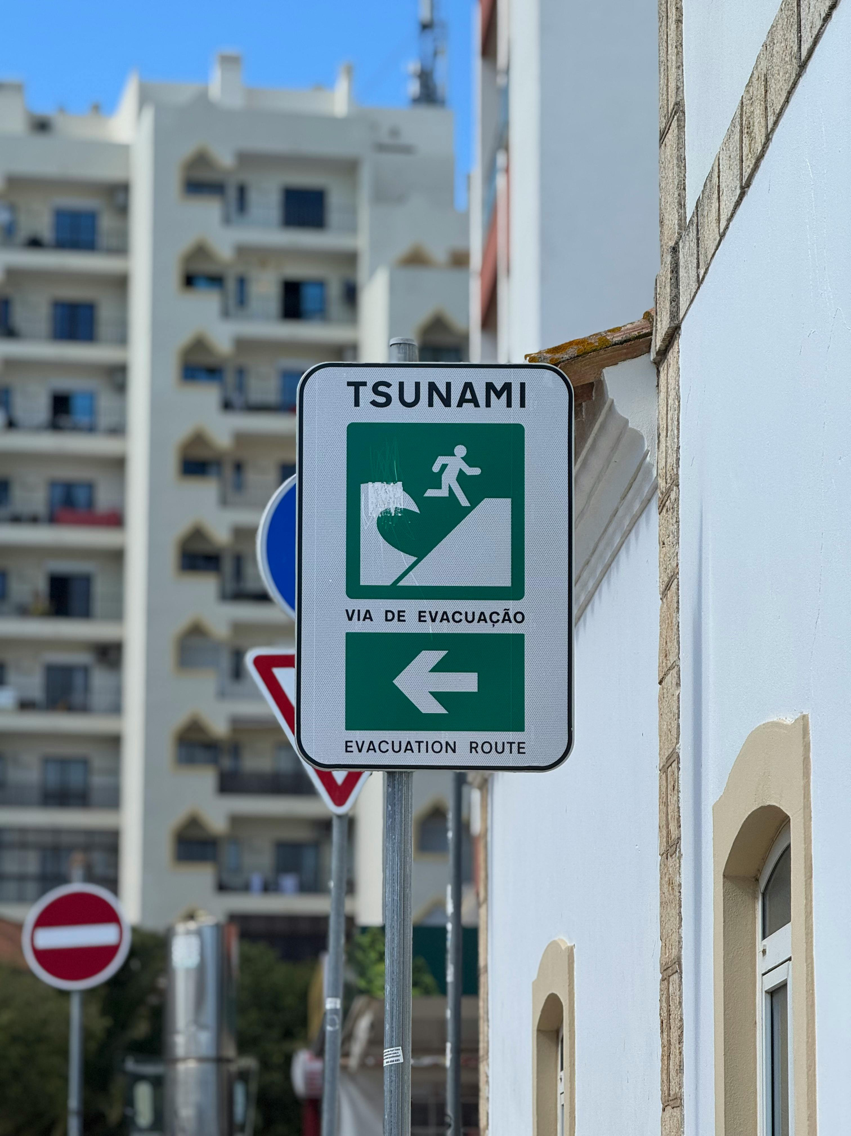
NORTH ACADEMY
THE MOST IMPORTANT ACTION
THE TIME TO LEARN YOUR EVACUATION ROUTE IS NOT WHEN A WARNING HAS BEEN ISSUED. BY THEN, THE ROAD MAY BE CROWDED, YOUR PHONE MAY BE UNRELIABLE, AND THE MINUTES AVAILABLE FOR REACHING SAFETY HAVE ALREADY BEGUN COUNTING DOWN
COMMUNITIES THAT HAVE CONDUCTED REGULAR EVACUATION DRILLS — IN SCHOOLS, WORKPLACES, AND RESIDENTIAL AREAS — CONSISTENTLY DEMONSTRATE FASTER AND MORE ORDERLY MOVEMENT TO SAFETY THAN THOSE RELYING ON UNTRAINED RESPONSE
THE PRACTICAL ACTIONS THAT MAKE THE DIFFERENCE ARE SIMPLE AND CAN BE COMPLETED IN A SINGLE AFTERNOON: IDENTIFY WHETHER YOUR HOME, SCHOOL, OR WORKPLACE IS WITHIN A MAPPED TSUNAMI INUNDATION ZONE

Slide 12

INUNDATION ZONES
COASTAL GEOGRAPHY AND AMPLIFICATION
TSUNAMI INUNDATION ZONES ARE AREAS IDENTIFIED BY SCIENTIFIC MODELLING AS POTENTIALLY BEING REACHED BY TSUNAMI WAVES UNDER DEFINED SCENARIOS
THE SHAPE OF A COASTLINE AND THE PROFILE OF THE SEAFLOOR BOTH INFLUENCE HOW TSUNAMI WAVES BEHAVE ON ARRIVAL
THE ROLE OF ELEVATION
NEAR-FIELD VERSUS FAR-FIELD EVENTS
ELEVATION IS THE MOST STRAIGHTFORWARD PROTECTIVE FACTOR IN TSUNAMI PREPAREDNESS. AREAS ABOVE THE MAPPED MAXIMUM INUNDATION ELEVATION
THE CRITICAL DISTINCTION FOR COMMUNITY PREPAREDNESS IS BETWEEN NEAR-FIELD TSUNAMIS (GENERATED BY AN EARTHQUAKE SOURCE CLOSE TO THE COASTLINE) AND FAR-FIELD TSUNAMIS (GENERATED AT A DISTANT SOURCE)
NORTH ACADEMY
UNDERSTANDING RISK
NOT ALL COASTAL AREAS FACE EQUAL TSUNAMI RISK — UNDERSTANDING INUNDATION ZONES, LOCAL GEOGRAPHY, AND THE DIFFERENCE BETWEEN NEAR-FIELD AND FAR-FIELD EVENTS IS ESSENTIAL FOR INFORMED PREPAREDNESS PLANNING

Slide 13
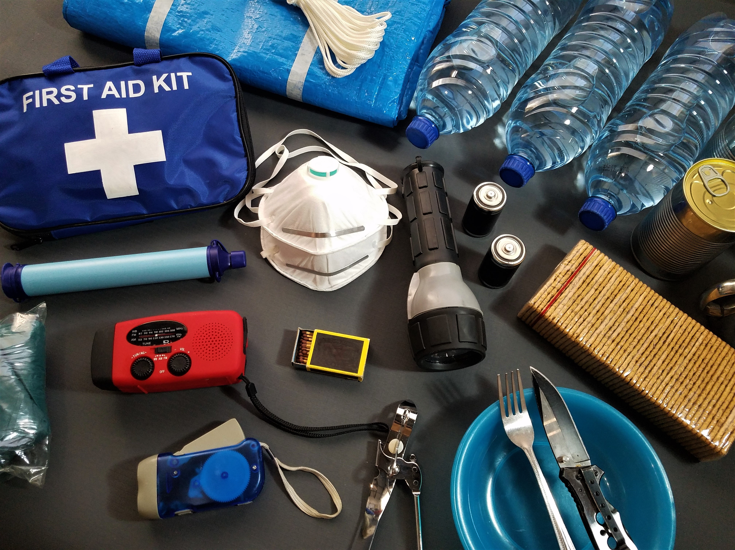
KNOW YOUR ZONE AND YOUR ROUTE
OBTAIN AND STUDY THE INUNDATION ZONE MAP FOR YOUR COMMUNITY
PREPARE AN EMERGENCY KIT
MAINTAIN A HOUSEHOLD EMERGENCY KIT CONTAINING AT MINIMUM
CREATE AND PRACTISE A HOUSEHOLD PLAN
ESTABLISH A CLEAR PLAN FOR HOW ALL HOUSEHOLD MEMBERS WILL RESPOND TO A WARNING
NORTH ACADEMY
REGISTER FOR OFFICIAL ALERTS
ENSURE THAT ALL HOUSEHOLD MEMBERS HAVE ENABLED EMERGENCY ALERT SYSTEMS ON THEIR MOBILE PHONES
COMMUNITY AND HOUSEHOLD PREPAREDNESS
PARTICIPATE IN COMMUNITY DRILLS
TAKE PART IN SCHEDULED COMMUNITY EVACUATION EXERCISES WHENEVER THEY ARE OFFERED

Slide 14

PREPAREDNESS IS A COMMUNITY PRACTICE
NORTH ACADEMY
TSUNAMI PREPAREDNESS IS MOST EFFECTIVE WHEN IT IS A SHARED COMMUNITY PRACTICE — BUILT THROUGH EDUCATION, REGULAR DRILLS, ACCESSIBLE INFORMATION, AND THE COLLECTIVE COMMITMENT TO KNOWING WHAT TO DO BEFORE ANY EVENT OCCURS
+123-456-7890
@REALLYGREATSITE
HELLO@REALLYGREATSITE.COM

Slide 15

NORTH ACADEMY
TSUNAMI SCIENCE IN NUMBERS
800 KM/H
~80%
M 7.0+
30 MIN
APPROXIMATE SPEED OF A TSUNAMI WAVE IN DEEP OCEAN WATER — SIMILAR TO A COMMERCIAL AIRCRAFT AT CRUISING SPEED
OF ALL TSUNAMIS THAT ORIGINATE IN THE PACIFIC OCEAN — THE REGION KNOWN AS THE RING OF FIRE, WHERE MOST OF THE WORLD'S SUBDUCTION ZONES ARE LOCATED
EARTHQUAKE MAGNITUDE THRESHOLD THAT MAY GENERATE A TSUNAMI — TRIGGERING IMMEDIATE ASSESSMENT BY WARNING CENTRES WORLDWIDE
TYPICAL MINIMUM EVACUATION TARGET TIME FOR COASTAL COMMUNITIES IN HIGH-RISK ZONES — THE PLANNING STANDARD USED BY EMERGENCY MANAGEMENT AGENCIES

